Slide 1
Fourier
Patrick Kevorkian

Slide 2
topics
intro to 2d discrete Fourier
phase
magnitude
Low pass filtering
High pass filtering
encryption

Slide 3

done on image rows
done on image columns
resulting matrix of real and imaginary numbers
2d Fourier

Slide 4
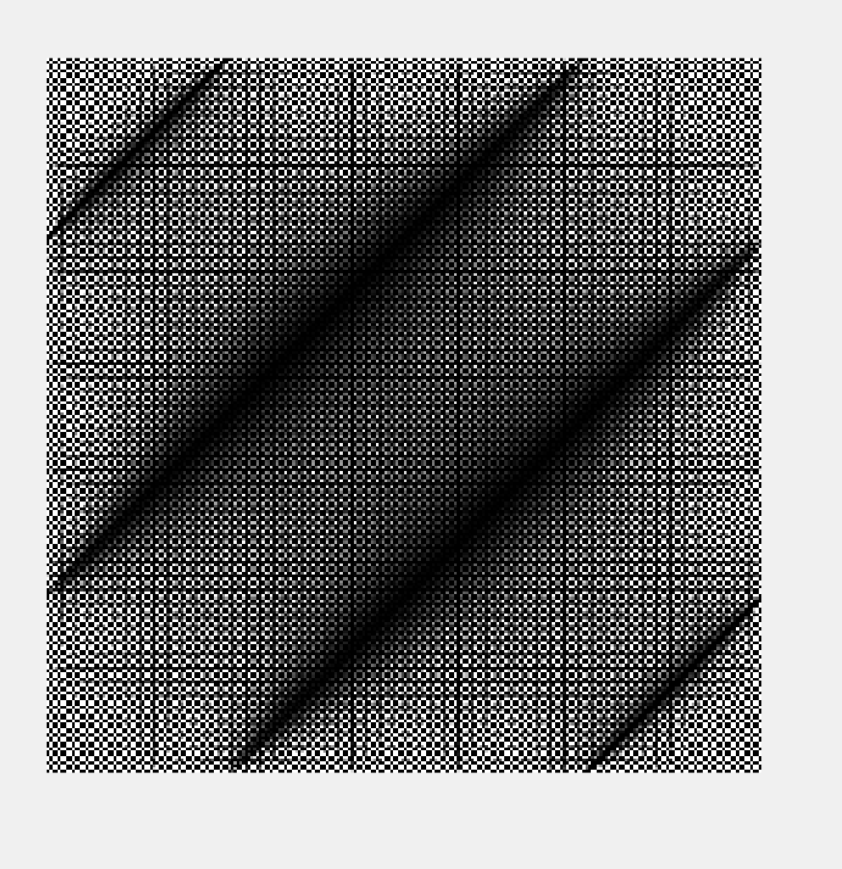
Here 2d transform has been applied (own function)
but it is not compete transform
application

Slide 5
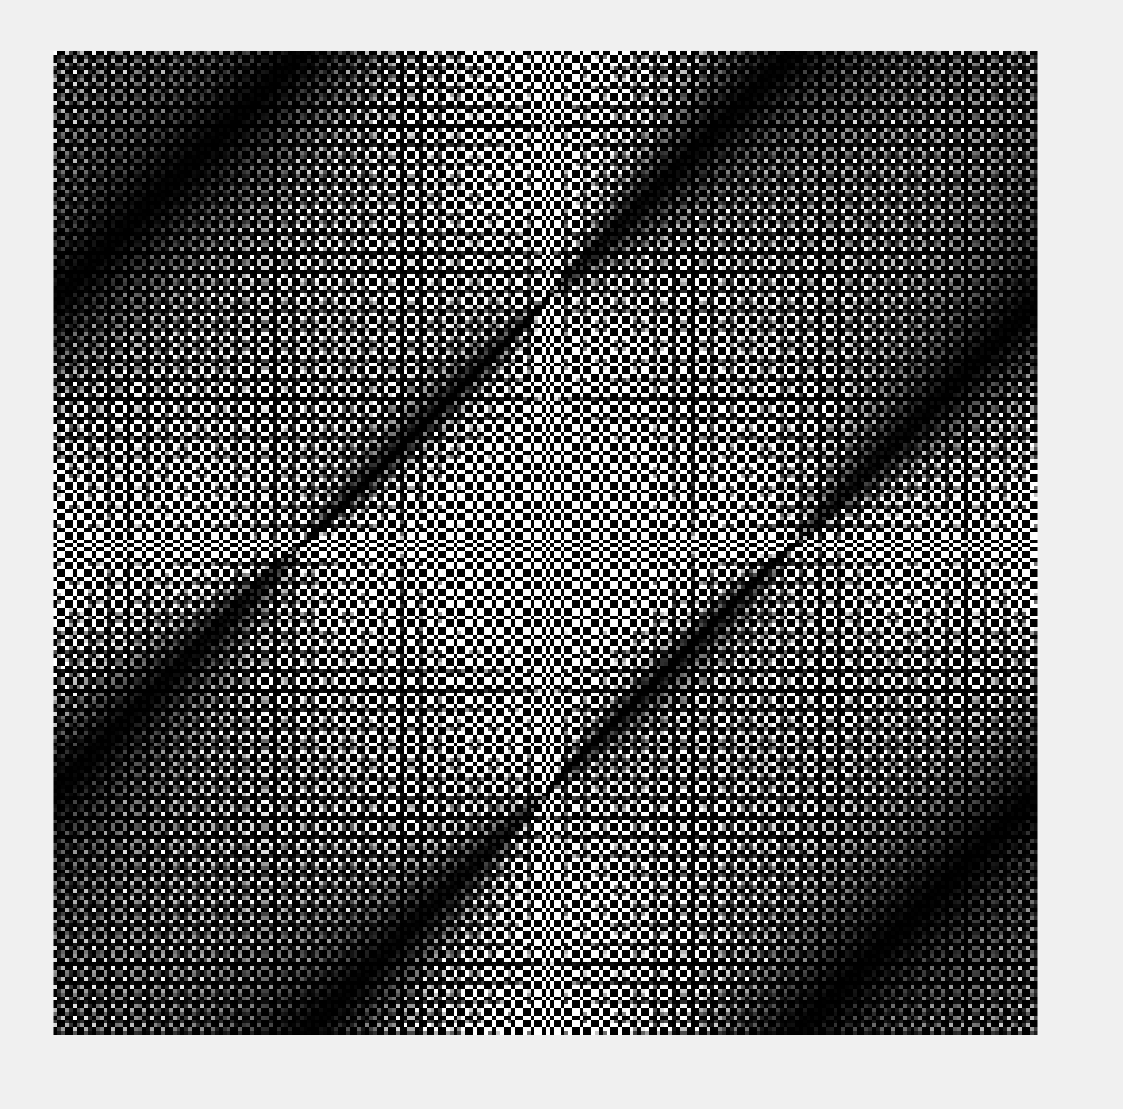
centering transform
Generally we see white edges and must correct this
We must center the previous image to see it correctly
To see edge detail
This is attained using Matlab’s Fourier shift function: fftshift()
Shifts to center

Slide 6
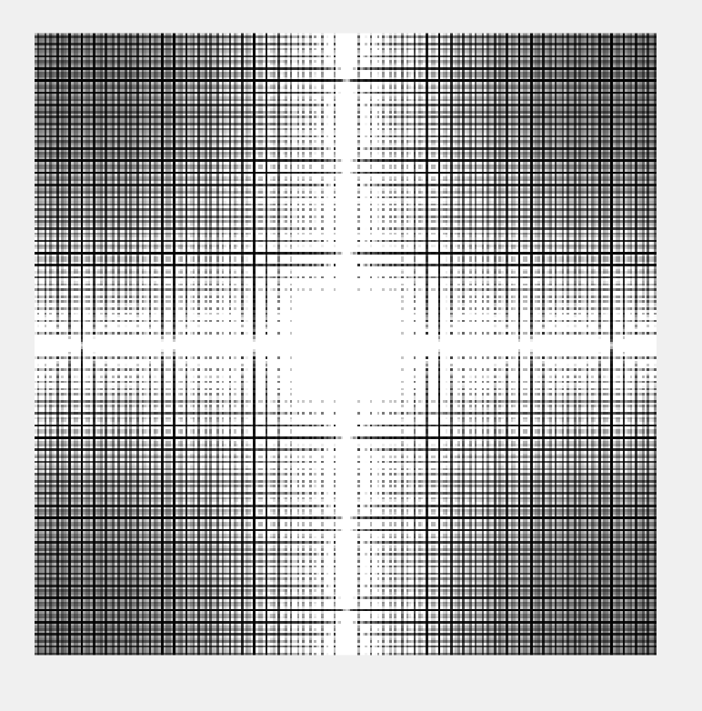
take 1+absolute value of previously shifted image
then lake log of that
in Matlab simply: proper image = log(1+abs(prevImage))
Viewing properly

Slide 7
phase
Fourier coefficients can be expresses as their real and imaginary parts
Phase can be expressed as: arctan(imaginary/real)
In Matlab this is done using the “angle()” function
This reruns the phase angle in radians
The next example we will see this process

Slide 8
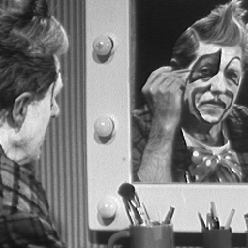
perform 2d Fourier as before
extract Phase information
shift to center
log transform
the value of each point determines the phase of the corresponding frequency
Clown Phase

Slide 9
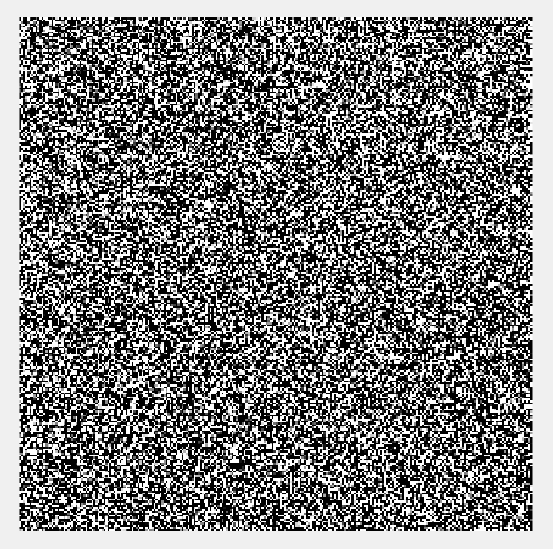
clown Phase

Slide 10
clown Magnitude
Defined as sqrt(real^2 + imaginary^2)
Can be achieved in Matlab with: abs(fourierOutput)
Then we take center and long transform
Results show that image contains components of all frequencies
But their magnitude gets smaller for higher frequencies
Low frequencies contain more image info than higher ones

Slide 11
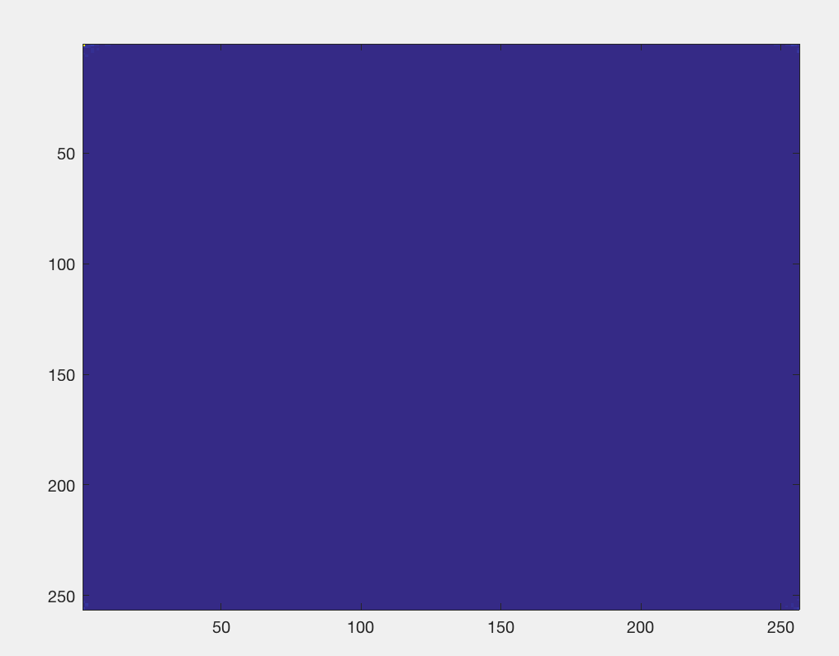
before log transform and center

Slide 12
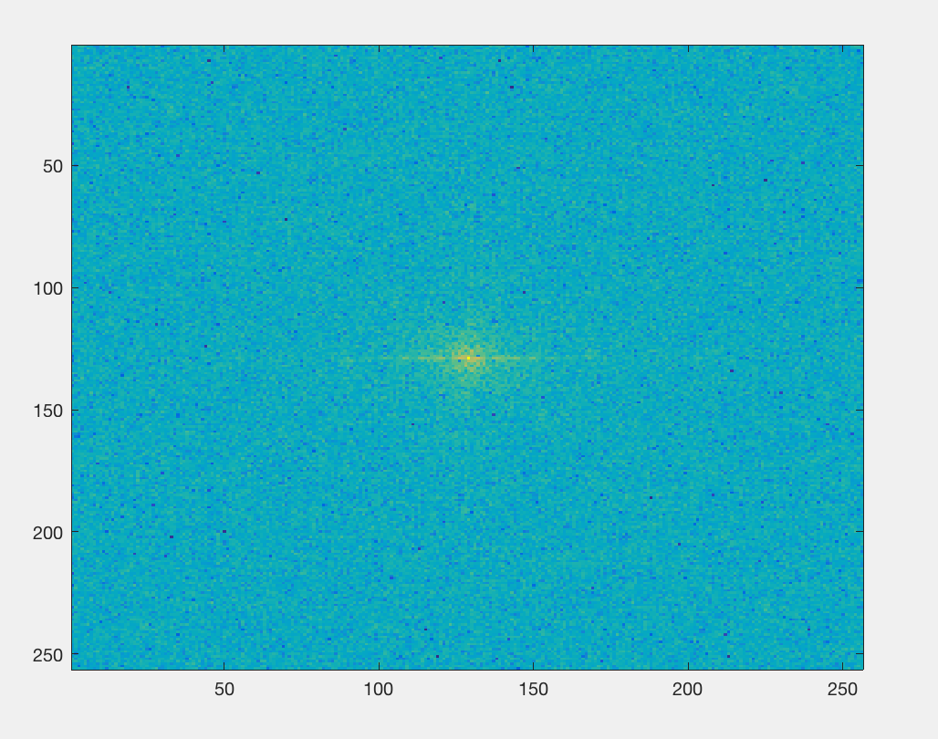
Magnitude

Slide 13
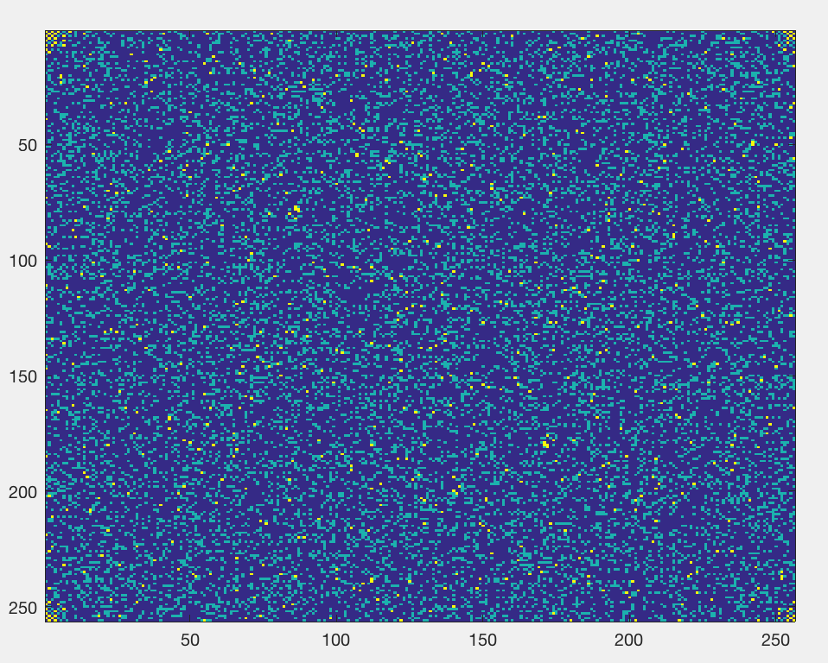
Do inverse 2d Fourier
leave phase information out
shows phase info is crucial to reconstruction
inverse magnitude

Slide 14
LowPass Filter
Performed in Fourier domain
Create a mesh grid
Create a circle with radius Zed, x^2 + y^2 is equal to Zed^2
The radius of the circle determines the cutoff point
To apply: convolution is a simple multiplication in the Fourier domain
Apply inverse Fourier on resulting convolution

Slide 15
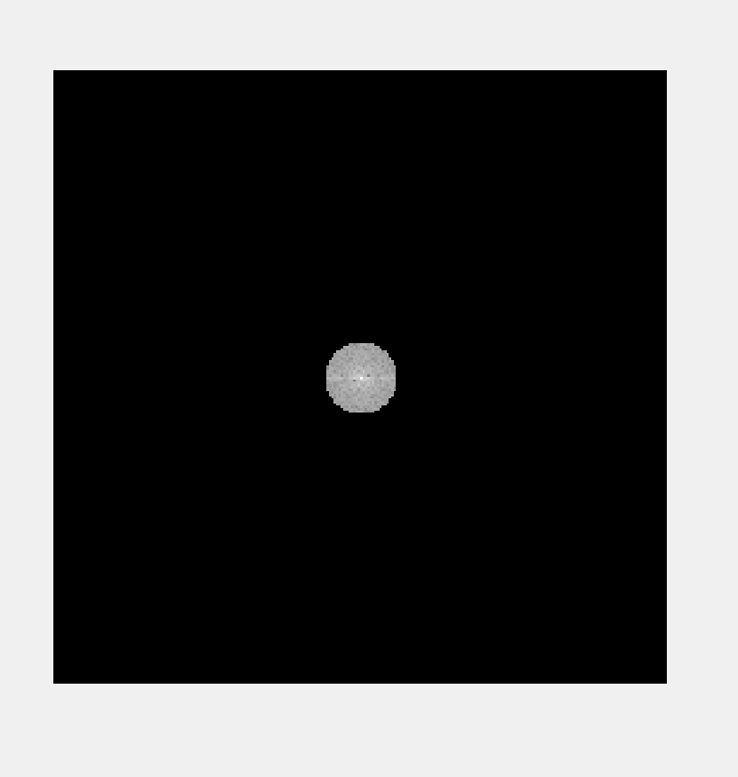
clown convolution

Slide 16
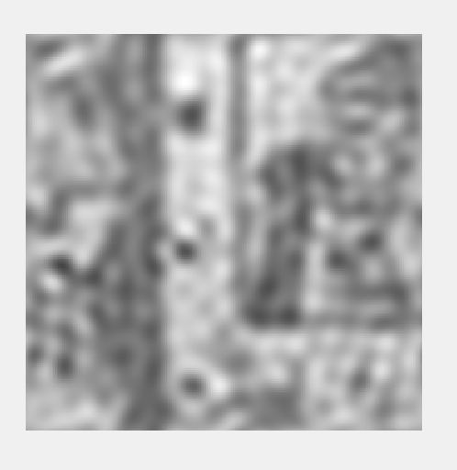
clown with lowpass filter
Same clown image
15 is our cutoff
Notice ringing due to radius of circle

Slide 17
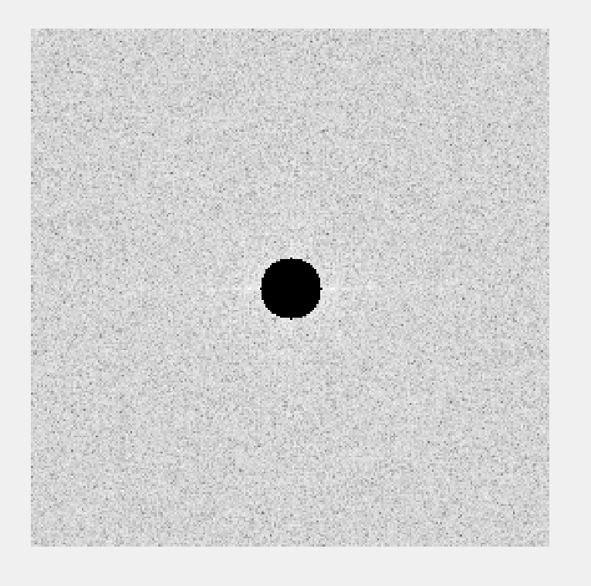
high paid filter
Same methodology as low pass
The distinct difference is that now Zed is greater than the cutoff
Convolution of high pass clown at 15
The higher the cutoff the larger the circle

Slide 18
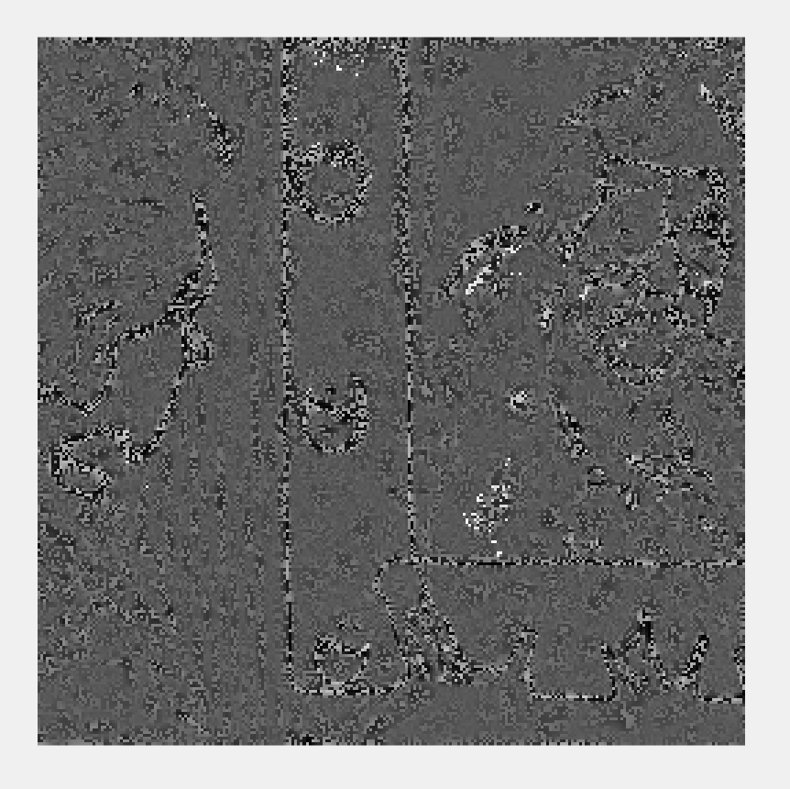
clown high pass 15
Clown image
15 cutoff
Shows edge information
The ringing effect is reduced the larger the radii

Slide 19
encryption

Slide 20
Self preposed encryption scheme
Image is broken don into phase Using Fourier
Randomly generate permutation matrix of same size
Phase pixels are shuffled with permutation matrix
Using inverse Fourier the new reconstructed image is formed from new Phase
Digest is this new image and key is permutation matrix
Recipient can run process in reverse with key to generate original image

Slide 21

Camera man example
Here we see the original image

Slide 22
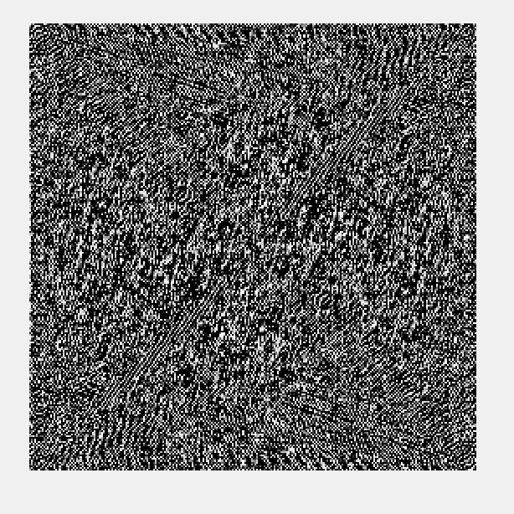
Original phase

Slide 23
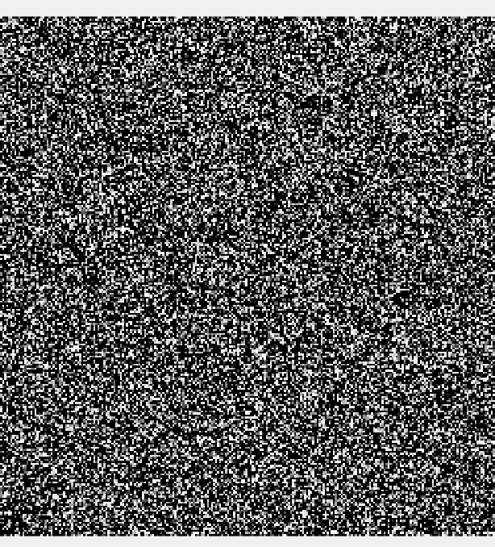
Permuted phase

Slide 24
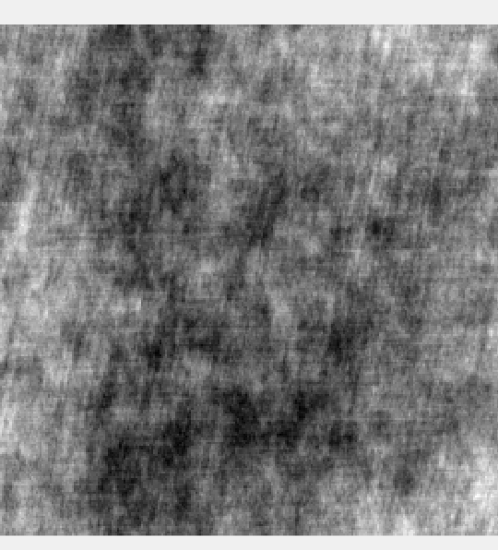
Encrypted Image

Slide 25
Decrypt
Process is reversed
Recipient is sent the encrypted image
Also sent the key (permutation matrix)
Matlab code provided
Random permutation generated is saved

Slide 26
Thank you

